Slide 1


Сигурност в Java
Кирил Гавраилов/SAP Labs Bulgaria Декември, 2013
Public

Slide 2
Съдържание
1 част
Последствия от проблеми в сигурността.
Видове Автентикация и Авторизация
Имплементация в Java web приложение.
Видове атаки и начини за предпазване от тях
2 част
Анализ на риска
Систематизиране на подхода при анализ на уязвимост на приложения – използване на дърво на атаката (attack tree);

Slide 3
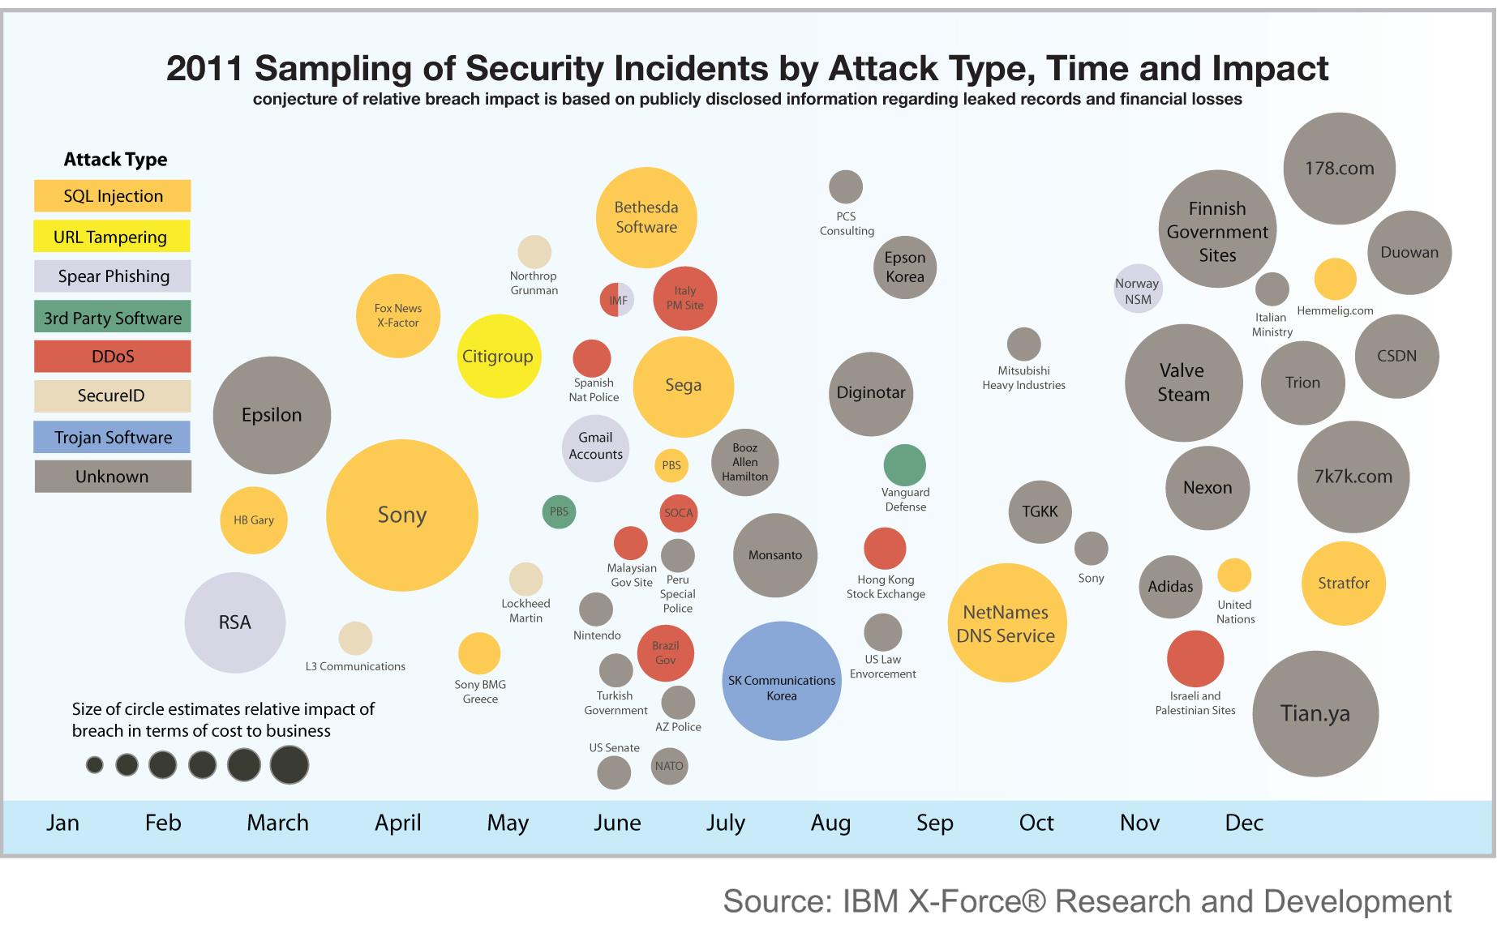
Последствия от проблеми в сигурността

Slide 4
Последствия от проблеми в сигурността
Sony
$171 million
RSA
$66 million
Diginotar
bankruptcy

Slide 5
Последствия от проблеми в сигурността
"There are only two types of companies those that have been hacked and those that will be.”
Robert Mueller, Director, FBI,
keynote speech at the RSA conference, 1 March 2012

Slide 6
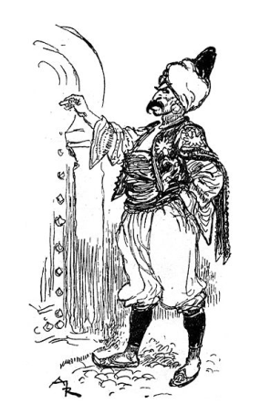

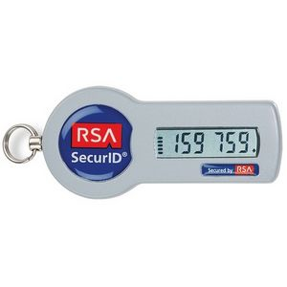



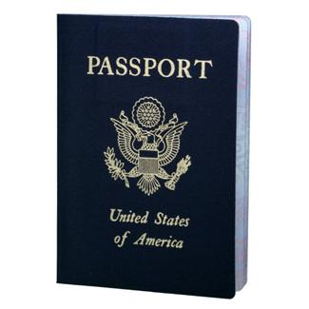
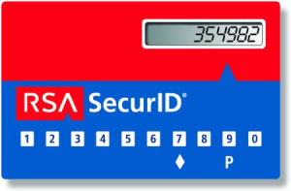
Автентикация – Authentication Personal Identity vs. Digital Identity Introduction
Identify a person (digital identity)
Different possible means how to identify a person
Something you know
Real world: Code-word “Open Sesame!”
IT equivalent: Password
Something you have
Real world: Key
IT equivalent: SecureID Token
Something you are
Real world: Face
IT equivalent: Face geometry, Fingerprint, Retina scan, …
Multiple means together: Multi-factor authentication
Real world: Passport + picture
IT equivalent: SecurID card + PIN
„mutti123“
Notes:
Key Message:
-> Purpose of authentication is to identify a person
-> Different mechanisms exist how to achieve this authentication
-> Combinations of these different mechanisms lead to even higher security
Slide notes:
-> In general, this authentication happens for instance
-> When an end-user wants to access a protected resource at an application server.
This is the point in time when the application server needs to determine who is accessing this protected resource
-> When a service is being accessed by either an application or another service on behalf of an end-user
-> Mechanisms for authentication make use of
-> usernames and passwords (something you know)
-> X.509 client certificates (something you have, as the private key of the certificate should be available only to you)
-> Biometric data
-> Multi-factor authentication combines different mechanisms to increase security
-> increased security

Slide 7
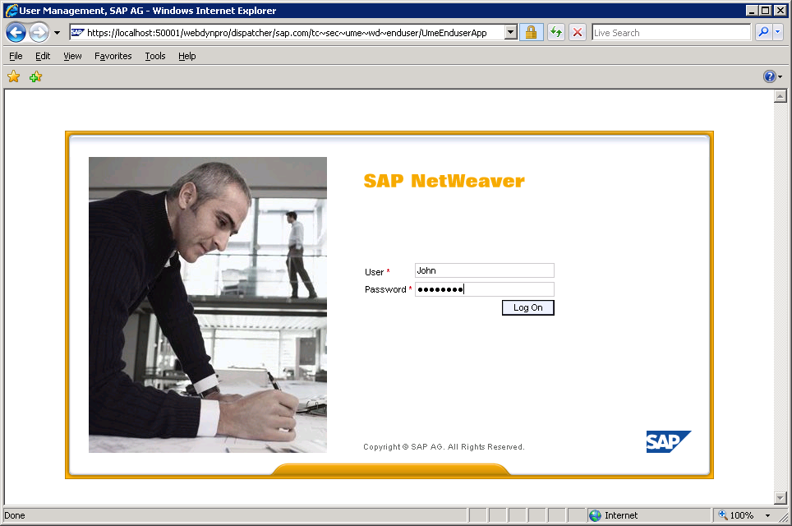
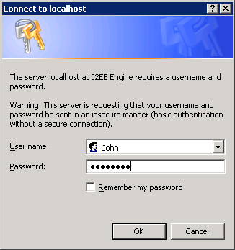
Автентикация - Authentication Front-End Authentication: Username & Password
FORM
Relies on customizable login form
Credentials transmitted as HTTP POST parameters
Credentials transmitted in clear text
SSL/TLS required for transport protection
Credentials not stored in browser
Explicit logoff possible
BASIC [Sent in the HTTP Header (base64 encoded <user>:<password>]
Relies on browser popup (gray, ugly)
Credentials transmitted as base64 encoded HTTP header
SSL/TLS required for transport protection
Credentials are stored in browser
Explicit logoff impossible
Notes:
Key Message:
-> Different standards for username & password authentication exist
-> Transport layer security (encryption) essential for all of them
Slide notes:
FORM based authentication
-> When a protected resource is accessed, the application server creates the configured login form which is rendered by the browser
-> This customizable login form allows to use the look and feel defined for the application server / application
-> Username and password are transmitted as (clear text) HTTP POST parameters in the HTTP body
-> SSL/TLS is required to protect the confidentiality of the clear text transmission from eavesdropping
-> The username and password are not automatically stored in the browser as opposed to BASIC for example
Note: Obviously browser features might opt to store form parameters (username and password), but that depends on the user’s choice.
-> As the credentials are not automatically submitted with subsequent requests, a regular logoff can be triggered by the user.
-> The HTTP POST method has already defined semantics in the context of RESTful web services (creation of a resource), therefore form based authentication might be unsuitable for REST
Note: Sensitive data should never be transmitted via HTTP GET, as URLs are logged and visible to proxies etc.
BASIC authentication
-> When a protected resource is accessed, the application server sends a challenge for authentication to the browser
-> The browser challenges the user for credentials by displaying a popup window which is part of the native browser application
-> There is no standard mechanism to adapt the look&feel of the browser popup to the look&feel of the application server / application
-> Username and password are transmitted as base64-encoded string in a defined HTTP header
-> This header is named (peculiarly) “Authorization” and the value is pre-fixed with “Basic “
-> SSL/TLS is required to protect the confidentiality of the base64-encoded transmission from eavesdropping
Note: Base64 encoding is no encryption, can be easily transformed to the original cleartext data, and therefore does not provide any confidentiality
-> Browser mechanisms ensure, that subsequent requests to the same HTTP BASIC realm contain the same HTTP Authorization header (and therefore the user’s credentials)
-> Regular logoff can be triggered by the user (possibly leading to a removal of session state at the server) but has potentially not the desired effect.
Note: The next request of the user is immediately re-authenticated with the existing HTTP Authorization header!
-> Usually, browsers do not provide mechanisms that the application server can trigger to remove the HTTP Authorization header.
-> Some browsers (latest version of Firefox for example) provide mechanisms for the user to manually trigger the removal of this header.
Note: Further username & password based mechanisms do exists (e. g. digest authentication) but they are outside the scope of this training.

Slide 8
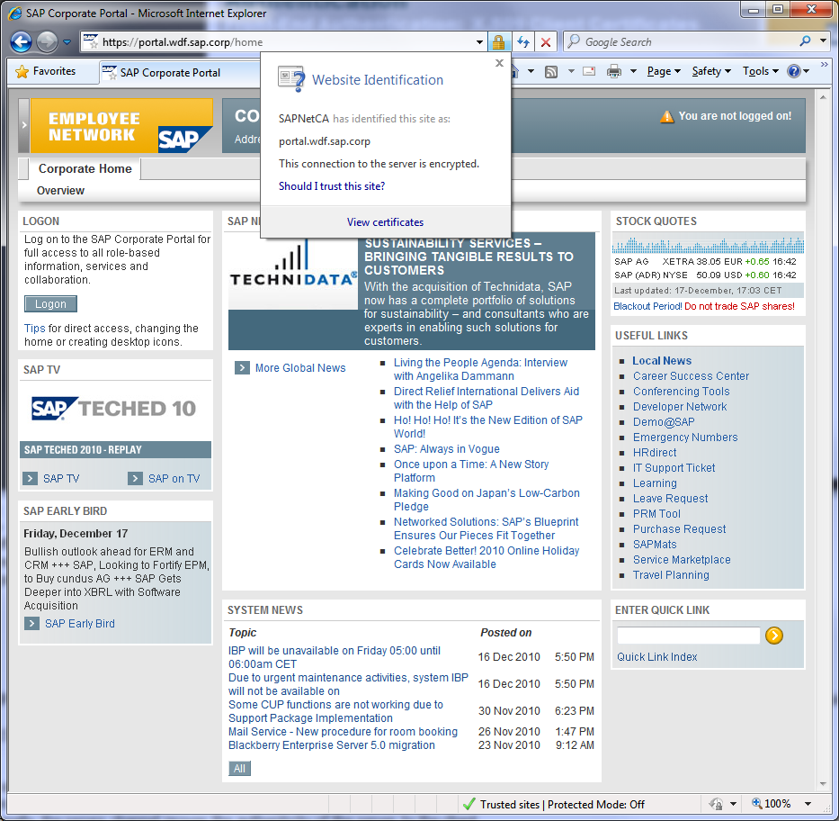
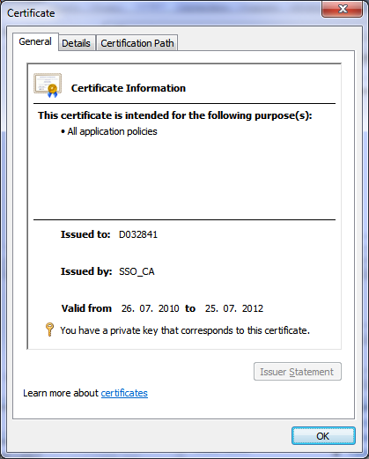
Автентикация - Authentication Front-End Authentication: X.509 Client Certificates
Transport Layer Security (TLS) and Secure Sockets Layer (SSL)
Traditionally used for channel encryption
Supports server authentication
Important: Supports also client authentication
TLS/SSL authentication with X.509 Client Certificates
Integration of client authentication in SSL handshake
Mapping of X.509 certificate content to user required
No sensitive data transmitted unencrypted
Explicit logoff impossible
Notes:
Key Message:
-> SSL/TLS offers not only server authentication but also client authentication
-> Standard mechanism, available for the majority of client and server products
-> Effort for public key infrastructure sometimes considered expensive
Slide notes:
-> The TCP/IP reference model explains different layers of communication protocols. SSL resides between TCP and the application level protocols.
-> HTTP Hypertext Transfer Protocol
-> SSL/TLS Secure Sockets Layers/Transport Layer Security
-> TCP Transmission Control Protocol
-> IP Internet Protocol
-> The main usage of TLS/SSL lies in providing a secure channel between the client/user agent and the server
-> The secure channel offers confidentiality and integrity protection
-> Additionally, the secure channel proves the authenticity of the server to the client
-> Optionally, the client may prove its authenticity to the server
-> Authentication with SSL/TLS relies on digital certificates
-> One common standard for digitial certificates is the X.509 standard
-> Usually, web servers own already a X.509 certificate for server authentication
-> Companies may hand out digital certificates also to their end-users using a Public Key Infrastructure
Note: SAP does so for its internal users with the SECUDE PKI solution
-> The certificate contains among other things
-> identifying information for the subject (e.g. the subject name)
-> information on the issuer of the certificate
-> validity time
-> a public key
-> and is digitally signed by the issuing Certificate Authority (CA)
-> The owner of the certificate owns the private key that corresponds to the certificate‘s public key
-> A key concept of SSL/TLS is the so-called “handshake” that takes part between the two parties (e.g. user agent and application server)
-> Both parties agree first on the cryptographic algorithms to use for the following SSL session
-> A challenge/response mechanism is used that authenticates the server to the client (including the download of the server certificate to the client)
-> If client authentication is configured, a second challenge/response mechanism authenticates the client to the server (including the transfer of the client certificate to the server)
-> Subsequently, key material is exchanged in order to setup a symmetrically encrypted secure channel
-> Mapping
-> In case of a successful handshake, the client’s certificate is available at the server
-> The server needs to determine a valid user for this certificate
-> Either the complete certificate (serialized) is mapped to a user
-> Or rule-based mechanisms can be used to determine the user based on information contained in the certificate
-> Sensitive data:
-> Private keys are not exchanged, therefore no sensitive data is exchanged during the handshake
-> The secrets to generate the symmetric key are transmitted and encrypted with the recipient’s public key
-> Regular logoff can be triggered by the user (possibly leading to a removal of session state at the server) but has potentially not the desired effect.
Note: The next request of the user is immediately re-authenticated using the existing X.509 client certificate
-> Managing the life-cycle of X.509 client certificates for users on computers, laptops, mobile devices etc. requires a Public Key Infrastructure.
Such solutions are available but considered as too expensive by some cost sensitive and security insensitive individuals ☺
Additional Note: X.509 client certificate based authentication is not considered as SSO despite the fact that the user does not manually authenticate. The result are separate sessions which are all bound to the same user agent, but independent from each other.

Slide 9


Автентикация - Authentication SAML 2.0 Example
Пример за Single Sign On автентикация:
Role: Service Provider (SP)
6. Supply Ressource
1. Request Ressource
2. <AuthnRequest>
5. <Response>
Role: Identity Provider (IdP)
4. User login
3. Challenge for credentials
Notes:
Key Message:
-> The identity provider is the central authentication entity
-> There are multiple service providers where the user wants to access resources via SSO
-> After authentication, the identity provider creates a session for the user (SSO)
-> Messages can be exchanged via the user‘s browser (cross-domain SSO possible)
Slide notes:
This example covers a single user case of the „Web Browser SSO Profile“ (SP initiated) which is defined in the SAML 2.0 standard.
Scenario:
There is a single IdP and a single SP. The user (user agent) is not authenticated at any of them yet.
Message Flow:
-> 1. The user requests a protected resource from the service provider
As the user is not authenticated at the service provider (has no session), the service provider generates an authentication request message for the configured identity provider.
The generated message is transmitted to the identity provider via the user‘s browser („Web Browser SSO Profile“!).
Remember: The exact mechanism for transmitting the message depends on the configured binding (e. g. HTTP POST)
-> 2. The identity provider receives the authentication request from the service provider via the user‘s browser.
As the user has no active session with the identity provider, the identity provider needs to authenticate the user.
-> 3. Authenticating the user is achieved by challenging the user for credentials (e. g. username & password)
Note: Any other mechanisms beside username & password can be used with the identity provider.
-> 4. The user provides the requested credentials to the identity provider for authentication.
The identity provider authenticates the user with the provided credentials and creates a session to facilitate future requests for that browser instance.
-> 5. The identity provider creates an authentication response message containing an assertion with an authentication statement.
The authentication statement identifies the authenticated user.
The generated message is transmitted to the service provider via the user‘s browser („Web Browser SSO Profile“!).
Remember: The exact mechanism for transmitting the message depends on the configured binding (e. g. HTTP POST)
-> 6. The service provider receives the authentication response from the identity provider via the user‘s browser.
Based on the content of the authentication response, a local service provider user is determined and a session is created for the browser
instance of the user at the service provider.
If the user is allowed to access the requested resource, it is supplied by the service provider to the user.
Note: The session generated for the user‘s browser instance at the identity provider ensures that subsequent authentication requests from other
service providers can be immediately answered by the identity provider without additional user interaction (i. e. single sign-on)!

Slide 10

Авторизация - Authorization

Slide 11
Видове Автентикация и Авторизация - User Management
Users
Digital representation of an individual in system
Groups
Container for bundling users and groups
Roles
Container for permissions
Notes:
Key Message:
-> Users represent individuals
-> Groups bundle users and groups (ease of administration)
-> Roles bundle permissions (more see later in authorization section)
Slide notes:
User
-> Has a set of attributes like logon identifier (e. g. D098765), first name, last name, email address etc.
-> Can also have one or more credentials (e.g. password, biometric digital representation of fingerprint, iris,…)
Group
-> Used for combining multiple users or also groups to ease administration tasks
-> Can also represent organizational structures depending on customer scenario
-> Expert advice: Groups could also be realized with roles only (bundling permissions and users), but group concept was derived from group concept of LDAP directories.
Role
-> Used to bundle permission in a system (e. g. A member of role „Manager“ may access the manager desktop in a corporate portal).
-> Role can be assigned to users or groups

Slide 12








Видове Автентикация и Авторизация - User Management
Create users and/or groups
Define roles in application
Map Roles to Users/Groups
Users
Digital representation of an individual in system
Groups
Container for bundling users and groups
Roles
Container for permissions
User 1
User 2
User 2
Manager Role
Manager Role
User 3
User 3
Group 1
Employee Role
User 1
User 4
Employee Role
Group 1
User 1
User 5
User 4
User 5
Notes:
Key Message:
-> Users represent individuals
-> Groups bundle users and groups (ease of administration)
-> Roles bundle permissions (more see later in authorization section)
Slide notes:
User
-> Has a set of attributes like logon identifier (e. g. D098765), first name, last name, email address etc.
-> Can also have one or more credentials (e.g. password, biometric digital representation of fingerprint, iris,…)
Group
-> Used for combining multiple users or also groups to ease administration tasks
-> Can also represent organizational structures depending on customer scenario
-> Expert advice: Groups could also be realized with roles only (bundling permissions and users), but group concept was derived from group concept of LDAP directories.
Role
-> Used to bundle permission in a system (e. g. A member of role „Manager“ may access the manager desktop in a corporate portal).
-> Role can be assigned to users or groups

Slide 13
Имплементация в Java web приложение - BASIC
<security-constraint>
<web-resource-collection>
<url-pattern>/resource/*</url-pattern>
</web-resource-collection>
<auth-constraint>
<role-name>Everyone</role-name>
</auth-constraint>
</security-constraint>
<login-config>
<auth-method>BASIC</auth-method>
</login-config>

Slide 14
Имплементация в Java web приложение - FORM
<security-constraint>
<web-resource-collection>
<url-pattern>/resource/*</url-pattern>
</web-resource-collection>
<auth-constraint>
<role-name>Everyone</role-name>
</auth-constraint>
</security-constraint>
<login-config>
<auth-method>FORM</auth-method>
<form-login-config>
<form-login-page>/logoin.jsp</form-login-page>
<form-error-page>/error.jsp</form-error-page>
</form-login-config>
</login-config>

Slide 15
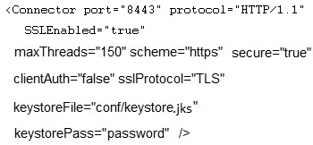
Имплементация в Java web приложение
TLS/SSL
Разрешаване на HTTPS
Криптирана комуникация между браузъра и сървъра;
Поддържа се сертификат за криптиране;
Notes:
keytool -genkey -alias tomcat -keystore keystore.jks
place the generated keystore.jks in conf folder of tomcat and set keystoreFile="conf/keystore.jks"

Slide 16


Одит на сигурността – Security Auditing Introduction
Security Auditing is about keeping track of who has when done what in a system
Security Auditing is important to…
detect wrong permission setup
detect attacks
track changes of privileges
track resource access
comply to legal requirements (e. g. FDA, SOX, …)
…
Examples for security audit events
User logged on successfully to the system
Unsuccessful logon attempt
User successfully accessed resources
Access to resources was denied
Role, action, permission changes
Role assignments
Notes:
Key Message:
-> Security Auditing is important not only for legal reasons, but also to protect the system itself!
Slide Notes:
Security Auditing is about keeping track of:
-> who (which user) has
-> when (system timestamp) done
-> what (action or event) in a system
Security Auditing is important to…
-> detect wrong permission setup:
Assignments of privileges to roles and users are traced and can be evaluated during security audits to ensure that users only have the privileges they are supposed to have.
-> detect attacks:
An increased number of failed logon attempts or failed permission checks can be a hint for external or internal attacks.
-> track changes of privileges:
Every single change of privileges might be critical.
-> track resource access:
Especially failed resource access is most likely a security issue although the motivation behind the might be completely different:
-> Either the user (good guy) does not have sufficient privileges to do his work (follow-up work for an administrator), or
-> an attacker (bad guy) tries to access resources
Also successful resource access might be worth tracking (e. g. for critical resources and compliance reasons)
-> comply to legal requirements like
->FDA (USA: Food and Drug Administration)
->SOX (USA: Sarbanes-Oxley Act)
-> … (other local laws and regulations)
Further Information:
Legal Security Auditing Requirements: https://portal.wdf.sap.corp/irj/portal?NavigationTarget=navurl://77c207260236b7849569ec6239665a79

Slide 17
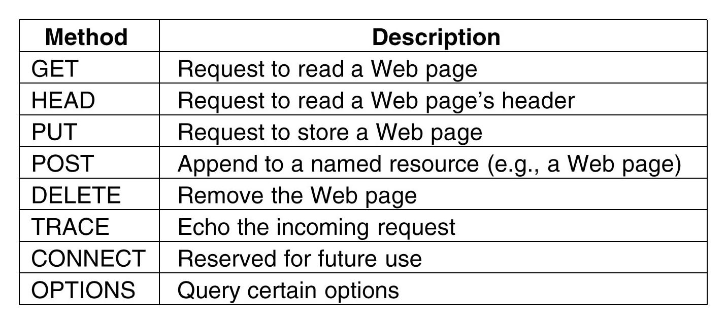
Verb Tampering Attack (Атака на подменения глагол)
HTTP Methods
GET
POST
HEAD
PUT
DELETE
TRACE
CONNECT
Custom

Slide 18
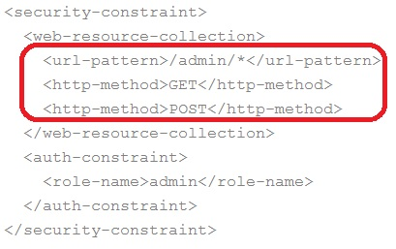
Verb Tampering Attack (Атака на подменения глагол)
Verb Tampering Attack
Как се прави?
Търси се подходящ servlet или JSP:
Да не ни трябва резултата
Да може да се извика HEAD вместо GET
Да се извършва критично действие
(примерно: добавяне или премахване на потребител, смяна на права и др.)

Slide 19
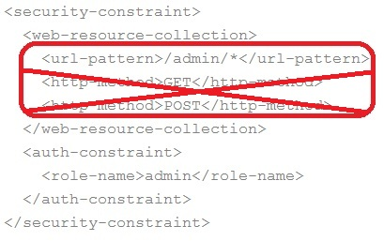
Verb Tampering Attack (Атака на подменения глагол)
Verb Tampering Attack
Как да се предпазим?
Всеки ресурс, който се защитава – се защитава за всички методи.
Не се специфицира метод, по който ресурса да е защитен.
Внимание: Много самоучители показват HTTP-METHOD таг.

Slide 20
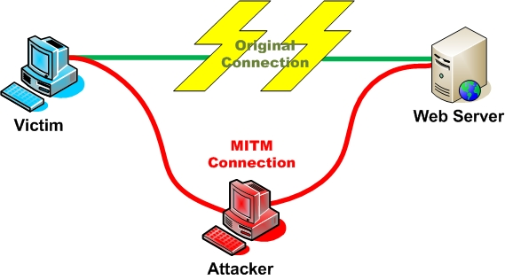
Човек по средата – Men in the Middle (MITM или MIM)
Атака човек по средата – Men in the Middle:
Прекъсва се оригиналната връзка
Атакуващия играе ролята на прокси
Има възможност да чете и/или модифицира данните.
Може да открадне session cookie или целия header.

Slide 21
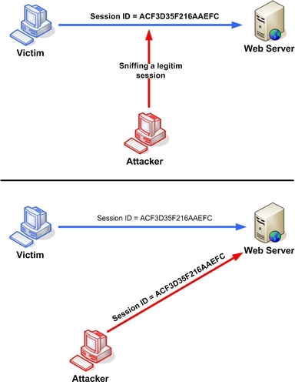
Session Hijacking – Отвличане на сесията
Атаката представлява открадване на token свързан със сесията с цел използване на не-авторизиран достъп до Web Server.
Може да се предаде предварително зададен token на клиента.

Slide 22
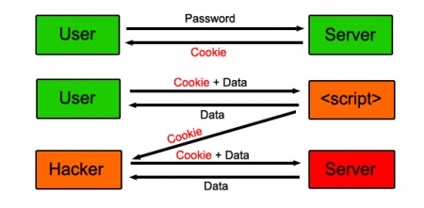
XSS – Cross Site Scripting

Slide 23

Phishing / Social engineering
Phishing – атакуващия се представя за някого на когото вярваш (най-често институция)
Извлича ценна информация
Дискедитира институцията
Обикновено 5% от потребителите се поддават на такава атака

Slide 24

Phishing / Social engineering
Често използвани похвати
Праща се линк по мейл, web-site, др. който изглежда като истинки с линк.
Инсталиране на шпионска програма:
Чака URL - показва логин форма;
Чака POSTзаявка, чете usr/pass поле;
Тършува за кукита ;
“Спешни” съобщения за hack и искане на действие от ваша страна онлайн;
Съобщения от отдел “Сигурност” приканващи да щракнете линк.

Slide 25

SQL Injection
SQL Injection
Атаката представлява вмъкване на SQL завяка през входни данни.
Успешна атака извлича важни данни от базата;
Или прменя данни в базата (създава, премахва, модифицира) права, потребители, други данни.

Slide 26
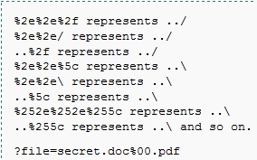
Path Traversal (backtracking) – Качване по директорий
Атаката цели да достъпи фйалове или директории, извън неговия application.
Използва се “../” за прескачане на директорийната структура;
Може да се достъпят сертификати;
Да се изпълни предварително качен злонамерен файл;
Обикновено се ползва spider програма за отриване на URLs
Notes:
A Path Traversal attack aims to access files and directories that are stored outside the web root folder. By browsing the application, the attacker looks for absolute links to files stored on the web server. By manipulating variables that reference files with “dot-dot-slash (../)” sequences and its variations, it may be possible to access arbitrary files and directories stored on file system, including application source code, configuration and critical system files, limited by system operational access control. The attacker uses “../” sequences to move up to root directory, thus permitting navigation through the file system.
This attack can be executed with an external malicious code injected on the path, like the Resource Injection attack. To perform this attack it’s not necessary to use a specific tool; attackers typically use a spider/crawler to detect all URLs available.
This attack is also known as “dot-dot-slash”, “directory traversal”, “directory climbing” and “backtracking”.

Slide 27

Анализ на Риска
Какви са ценните неща
Какво бихме загубили ако попаднбе в грешни ръце;
- Бизнес влияние
- Технически аспект
Риск = Вероятност да се случи * Тежест на ефекта

Slide 28
Дърво на атаката – Attack tree
Step 1:
Define assets

Slide 29

Дърво на атаката – Attack tree
Personal data
Credit cards
Items details
Company image
Assets

Slide 30
Дърво на атаката – Attack tree
Credit card
Steal credit card details
Buy on behalf of the user
Attacker logs-in as user
Attacker gets DB access
Trick the user into buying
Attacker logs-in as user
…
…
…
…

Slide 31
Дърво на атаката – Attack tree
…
Attacker logs-in as user
Steal password
Hijack session
Misuse session management implementation
MIM
attack
SQL
injection
…
…
use https
use prepared statements

Slide 32
Дърво на атаката – Attack tree
Credit card information
Steal credit card details
Attacker logs-in as owner
Steal password
MIM attack
Hijack session
MIM attack
XSS attack
Misuse of SM impl.
SQL injection
Attacker gets DB access
Attacker uses application vulnerability
SQL injection
Access control attack
Attacker uses infrastructure vulnerability
No firewall
Buy on behalf of the user
Trick the user into buying
CSRF attack
Attacker logs-in as user
Unsecure DB passwords
Unsecure storage of DB passwords
use https
use https
escape output
use prepared statement
use prepared statement
use fine-grained control
install firewall
enforce password policy
use secure storage
use CSRF protection mechanism
…

Slide 33

Дърво на атаката – Attack tree
Step 3:
List security requirements

Slide 34
Дърво на атаката – Attack tree
Security requirements
Use https
Escape output
Use fine-grained control
User CSRF protection mechanisms for critical actions
Enforce password policy
Use prepared statements
Use secure storage for passwords
Install firewall
Use secure session management implementation

Slide 35
Дърво на атаката – Attack tree
Why use attack trees?
Quick vulnerability identification
Security requirements definition
Easier prioritization
Documentation of protection measures
No expensive tools needed

Slide 36
Благодаря за вниманието!
За контакти:
k.gavrailov@sap.com
SAP Labs Bulgaria
София 1618
бул. Цар Борис III, 136А
тел: 02 91 57 610

Slide 37
Последствия от проблеми в сигурността
1. $171 million – Sony
2. $2.7 million – Citigroup
3. $2 million – Stratfor
4. $2 million – AT&T
5. $1 million – Fidelity Investments, Scottrade, E*Trade, Charles Schwab

Slide 38
Приложение
Тук можеше да има прикачени файлове с код, примери и т.н. Но няма ☺

Slide 39
ИЗПОЛЗВАНА ЛИТЕРАТУРА
http://onjava.com/pub/a/onjava/2002/06/12/form.html
https://www.owasp.org/index.php/Guide_to_Authorization
http://www.devarticles.com/c/a/Java/JAAS-Securing-J2EE-Applications-Securing-Web-Components/2/
http://www.itworld.com/development/80705/how-enable-https-tomcat
https://www.owasp.org/index.php/Man-in-the-middle_attack
http://www.youtube.com/watch?v=lAzIOwq2H_U
https://www.owasp.org/index.php/OWASP_Risk_Rating_Methodology
https://www.owasp.org/index.php/Path_traversal

